Slide 1
How to define a fulfillment unit rule for a fixed date (end of semester)
Yoel Kortick
Senior Librarian

Slide 2

Agenda
Introduction
The configuration - step 1
The configuration - step 2
The configuration - step 3
The configuration - step 4
The configuration - step 5
Test the Fulfillment Unit rule

Slide 3
Introduction

Slide 4
Introduction
There are cases where the institution wants to be able to loan items and have the due date be a fixed date.
Instead of stating, for example, that item will be due "30 days" or "one month" or "two days" from the time it is loaned, the institution may want to say that the due date will automatically be "Nov. 29" or "When the next semester begins" (which may be Sept. 1).
In this presentation we will explain how this can be done.

Slide 5
Introduction
The steps we will follow are:
Define a calendar event for the fixed date. We will state that June 28, 2024, is the last day of the semester.
Define an "advanced policy configuration" of type "Due Date" called "Due at end of semester". It will use the calendar event made above.
Make a Terms of Use of type "Loan" called "Due at end of semester". It will use the "advanced policy configuration" made above of type "Due Date"
Create an Item Policy called "Due at end of semester"
Make a fulfillment unit rule which uses the above terms of use "Due at end of semester" and Item Policy called "Due at end of semester"
Test the fulfillment unit rule by loaning an item which has Item Policy called "Due at end of semester" and check the due date.

Slide 6
The configuration - step 1

Slide 7
The configuration - step 1
Step 1: Define a calendar event for the fixed date. We will state that June 28, 2024, is the last day of the semester.
This is done at "Configuration > Configure for institution > Fulfillment > Library Management > Opening Hours"
Switch to "Calendar Management" tab.
Click "Add Record"
Make the record type be "Event"
Fill in the "Fixed Date Description" and the "Date"
Click "Add and Close"
Click "Apply Changes"

Slide 8
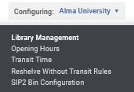
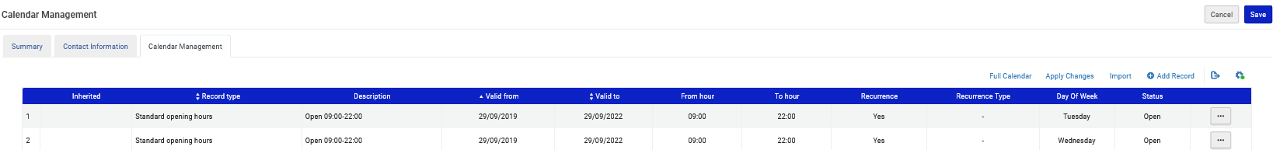
The configuration - step 1
Institution (not a specific library)

Slide 9
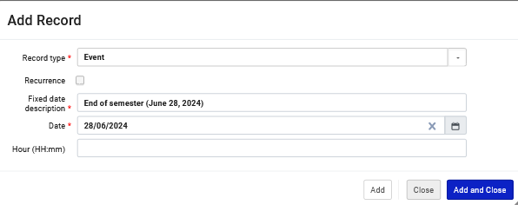
The configuration - step 1
Here is the new record we are adding to the calendar:

Slide 10
The configuration - step 1
See the new event and apply changes.

Slide 11
The configuration - step 2

Slide 12
The configuration - step 2
Step 2: Define an "advanced policy configuration" of type "Due Date" called "Due at end of semester"
This is done at "Configuration > Fulfillment > Physical Fulfillment > Advanced Policy Configuration > Add Fulfillment Policy > Choose Type 'Due Date' > Click 'Next'".
We receive the "Policy Details" page which appears on the next screen.

Slide 13
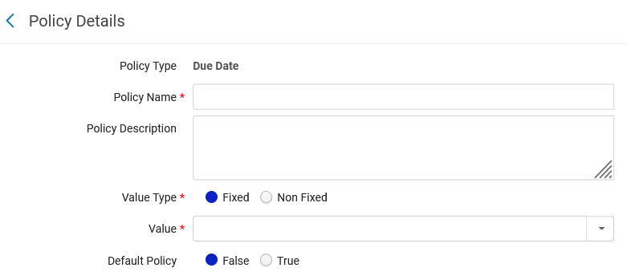
The configuration - step 2

Slide 14
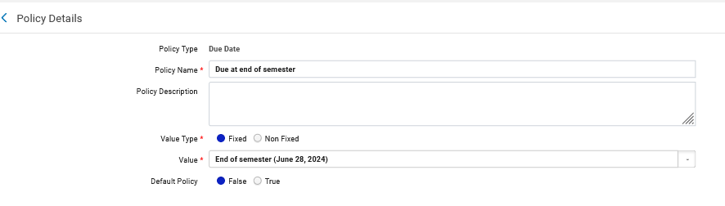
The configuration - step 2
We will fill in the Policy Details as follows:
We have chosen Value Type "Fixed" because we want to choose a fixed date based on an event in the Institution Calendar.
After choosing Value Type "Fixed" we can choose in the "Value" the events from the calendar. This is the event we created a moment ago.

Slide 15
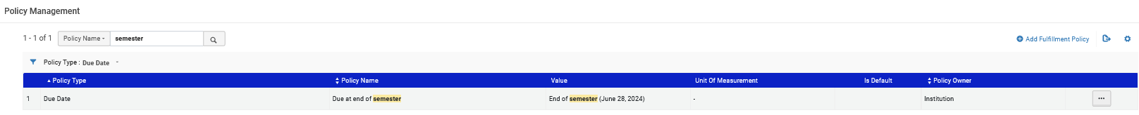
The configuration - step 2
We have done step 2 and defined an "advanced policy configuration" of type "Due Date" called "Due at end of semester"

Slide 16
The configuration - step 3

Slide 17
The configuration - step 3
Step 3: Make a Terms of Use of type "Loan" called "Due at end of semester". It will use the "advanced policy configuration" made above of type "Due Date".
This is done at "Configuration > Fulfillment > Physical Fulfillment > Terms of Use and Policies > Add a Terms Of Use > Choose Terms of Use type 'Loan' > Click 'Next'".
We receive the "Terms of Use Management" page which appears on the next screen.

Slide 18
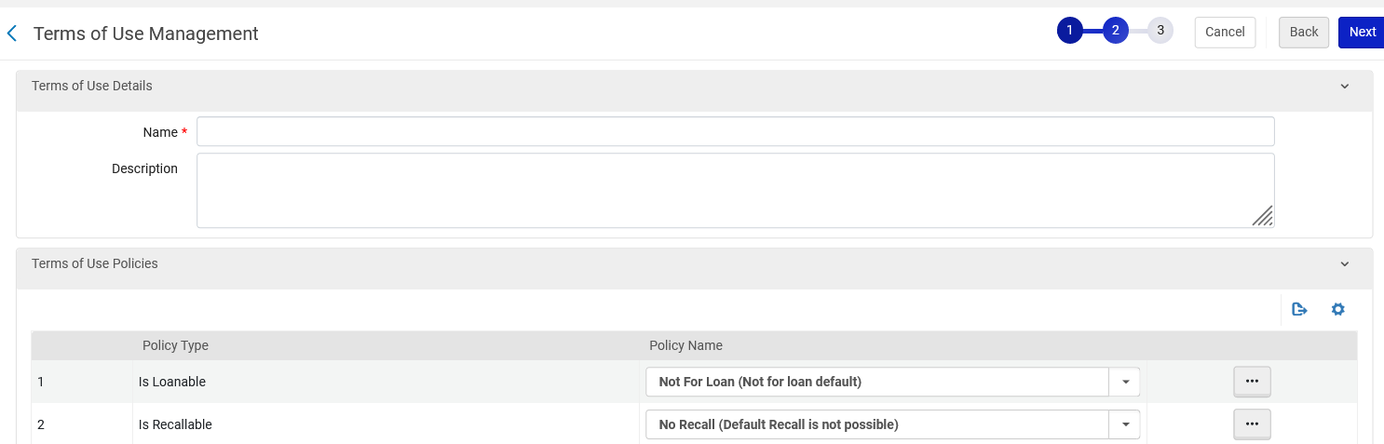
The configuration - step 3

Slide 19
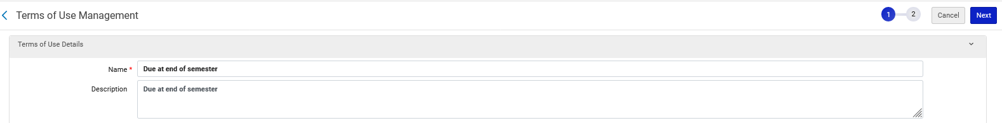
The configuration - step 3
We will fill in the Terms of Use Details as follows:

Slide 20
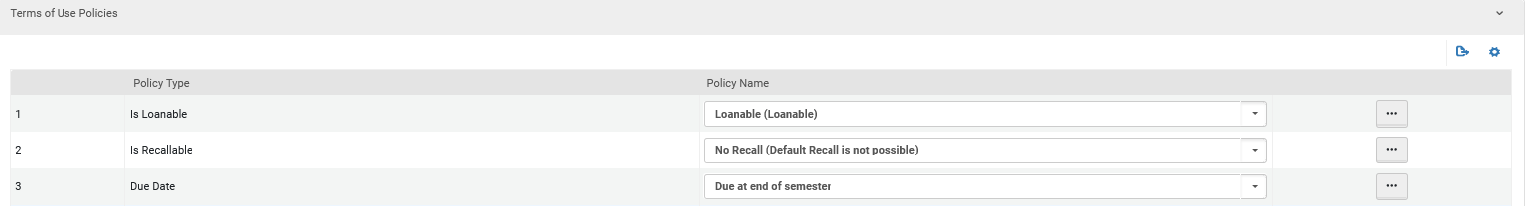
The configuration - step 3
We will fill in the Terms of Use Policies as follows:
This is the "advanced policy configuration" of type "Due Date" which we created in step 2.
Item is Loanable

Slide 21
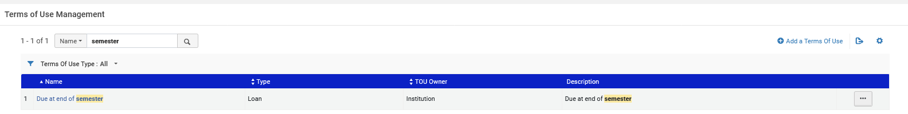
The configuration - step 3
We have done step 3 and defined a Terms of Use of type "Loan" called "Due at end of semester".

Slide 22
The configuration - step 4

Slide 23
The configuration - step 4
Step 4: Create an Item Policy called "Due at end of semester"
This is done at "Configuration > Fulfillment > Physical Fulfillment > Item Policy > click 'Add Row'".
We receive the "Add Row" box which appears on the next screen.

Slide 24
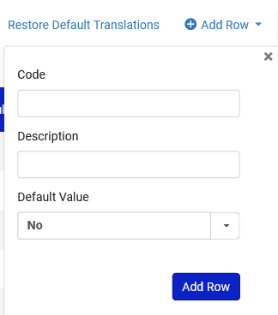
The configuration - step 4

Slide 25
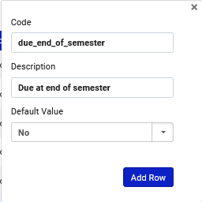
The configuration - step 4
We will fill in as follows:

Slide 26
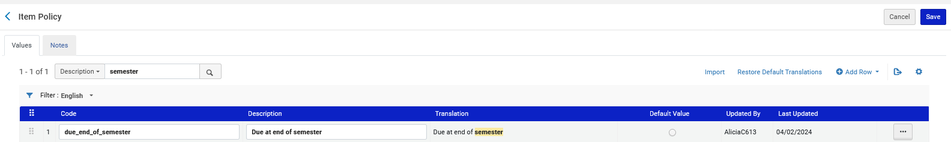
The configuration - step 4
We have done step 4 and defined an "Item Policy" called "Due at end of semester"

Slide 27
The configuration - step 5

Slide 28
The configuration - step 5
Step 5: Make a fulfillment unit rule which uses the above terms of use "Due at end of semester"
This is done at "Configuration > Fulfillment > Physical Fulfillment > Fulfillment Units > Edit the relevant Fulfillment Unit (which contains the locations of items to which the rule will apply) > switch to tab 'Fulfillment Unit Rules' > select Rule Type "Loan" > click 'Add Rule'".
We receive the "Fulfillment Unit Rules Editor" page which appears on the next screen.

Slide 29
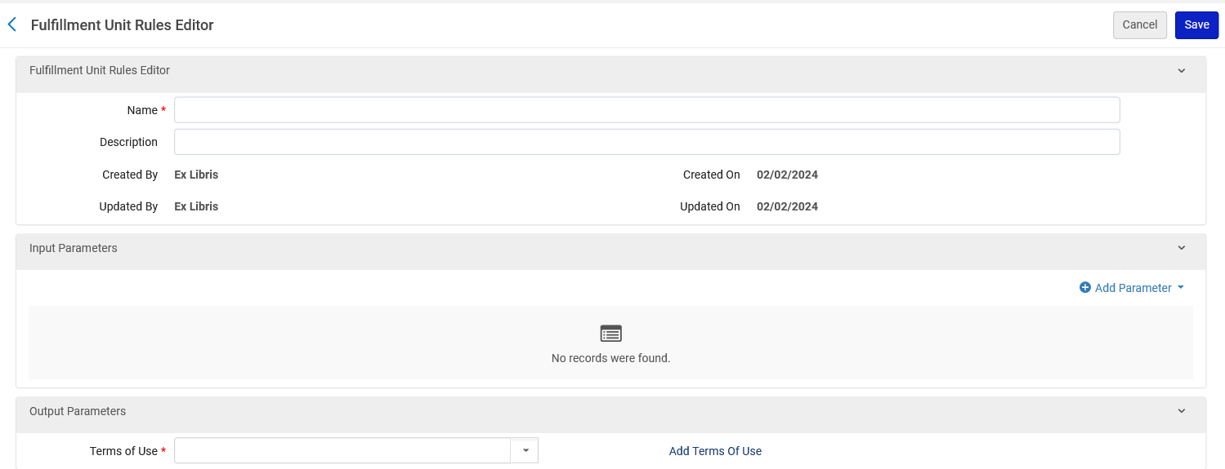
The configuration - step 5

Slide 30
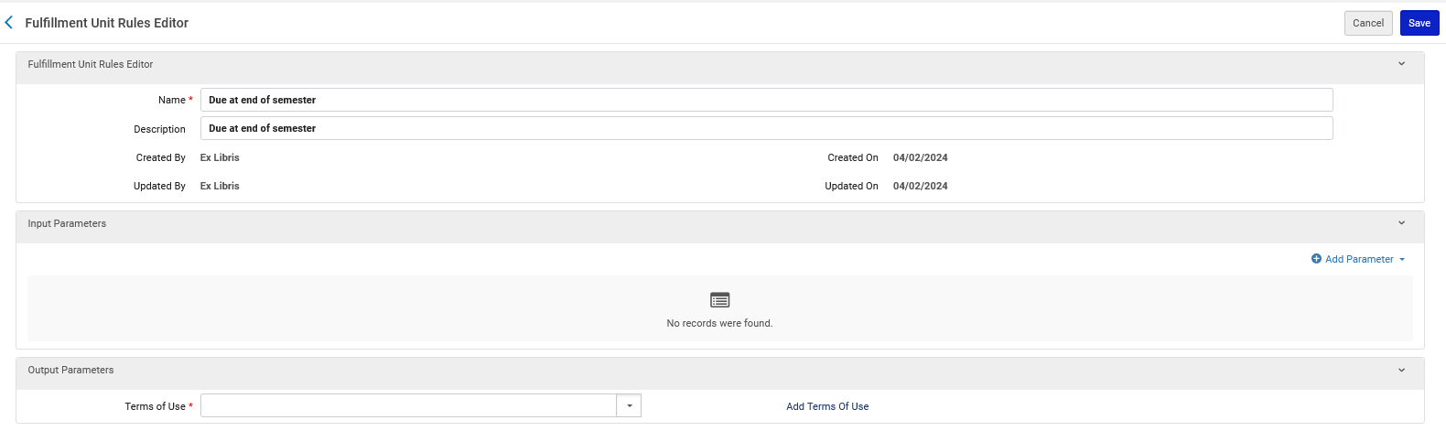
The configuration - step 5
We will call the rule "Due at end of semester"
We will give it the same description
Now we will click "Add Parameter"

Slide 31
The configuration - step 5
After clicking "Add parameter" we define the conditions for the rule.
We will state:
If
the item policy = "Due at end of semester"
then
use Terms of Use "Due at end of semester"

Slide 32
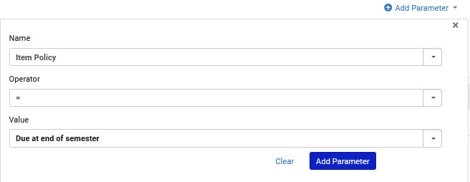
The configuration - step 5
After clicking "Add parameter":
We could have used many other parameters here such as item location or patron user group

Slide 33
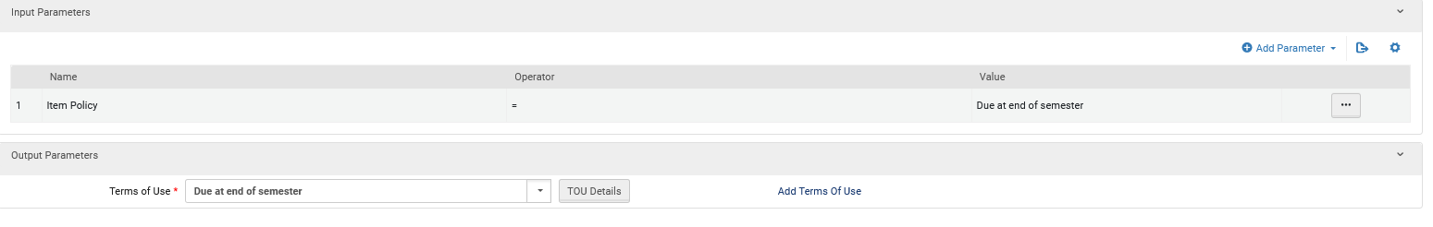
The configuration - step 5
Now we choose the Terms of Use which we previously made

Slide 34
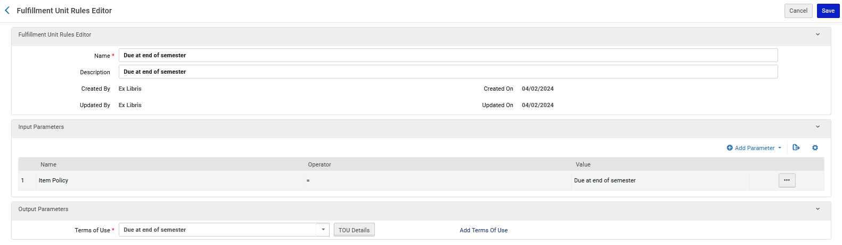
The configuration - step 5
Here is the rule
If the condition in the "Input Parameters" exists, then use the Terms of Use on the "Output Parameters"

Slide 35
Test the Fulfillment Unit rule

Slide 36
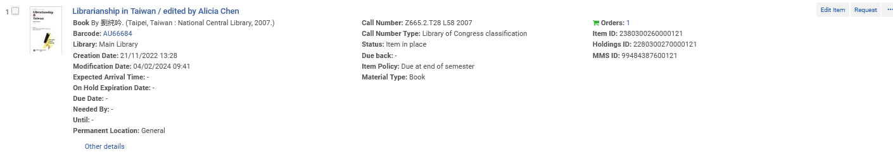
Test the Fulfillment Unit rule
Barcode AU66684 is in the Main Library General Location, which is part of the Fulfillment Unit in which we made the Loan rule.
It has item policy "Due at end of semester"

Slide 37
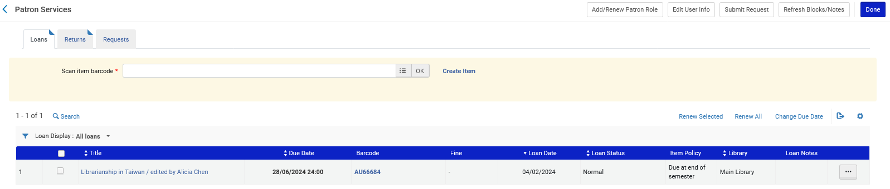
Test the Fulfillment Unit rule
We loan this item to patron Aaron Hacohen.
It has a Due Date of June 28, 2024.
It is correctly loaned until the end of the semester

